Slide 1


OpenC2 + OrchID
Using OpenC2 in a Managed Security Services Provider
Adam Bradbury – Security Architect & SOC Team Leader

Slide 2
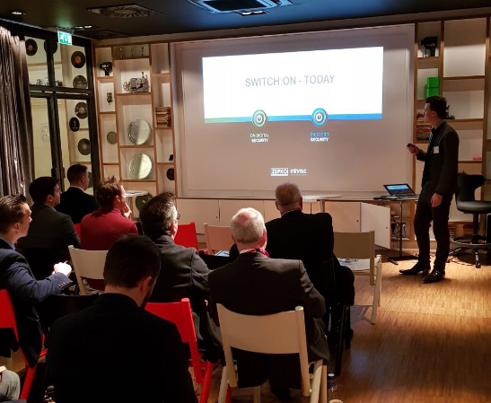
Who am I?
My Role At Zepko:
Architect
SOC Manager
InfoSec Speaker
Fields of expertise:
SME Security
IDS / IPS / AV / SIEM
Big Data (ElasticSearch, Hadoop, Spark)
Security System Design
Certified Ethical Hacker
Threat Intelligence
Automation / ML
Email: Adam.Bradbury@Zepko.com
Twitter: @AdamTheAnalyst
LinkedIn: https://uk.linkedin.com/in/adamtheanalyst

Slide 3


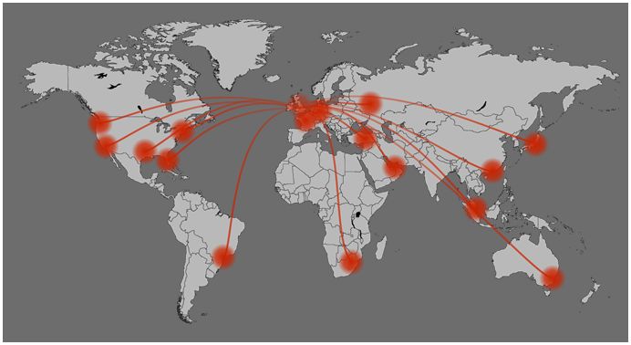
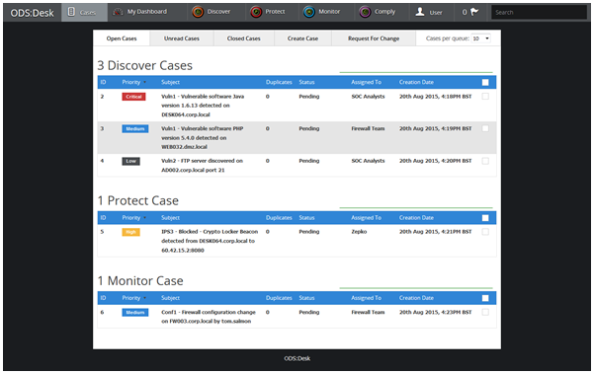
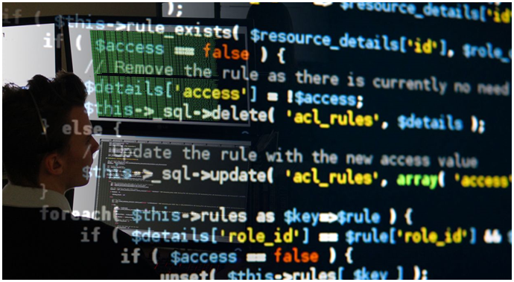
Who Are Zepko?
Founded in 2004, over 13 years of focused IT security experience.
Security Operations Centre (SOC) located in Birmingham, UK
Global threat intelligence visibility.
We provide comprehensive monitoring and protection with deep sector knowledge.
Dedicated software development team supports our service lines and provides tailored solutions.

Slide 4

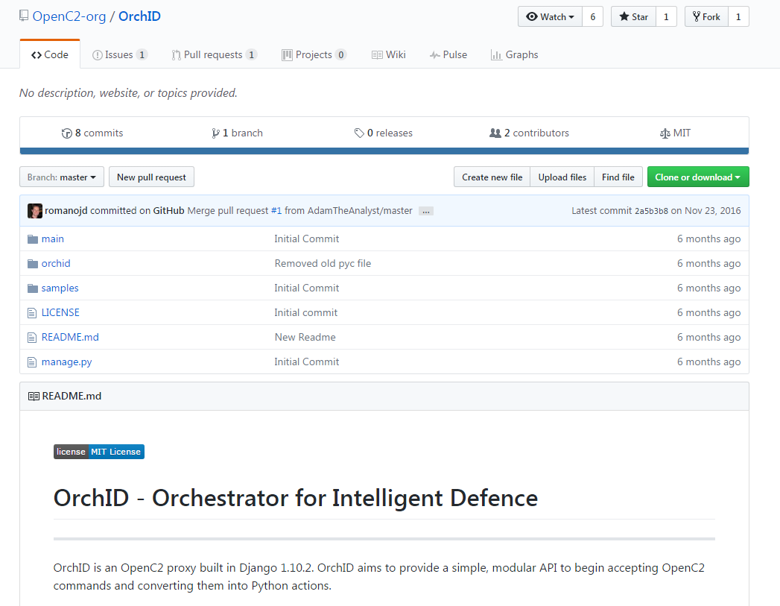
Introducing OrchID
OpenC2 Proxy (OpenC2->Vendor)
Open Source
HTTPS REST API
Written In Python
Highly modular (Pulls welcomed)
Supports response messages
In production for 4+ months

Slide 5

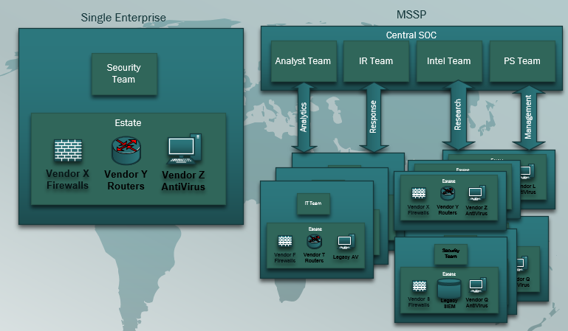
Problems with MSSP’s and Incident Response

Slide 6

How we’re solving our problems with OpenC2 & OrchID - Enrichment
Enrichment: Using OpenC2 to attach interesting or relevant information to a security incident before an analyst has had chance to begin the investigation.
Benefits:
- Removal of repetitive analyst work loads
- Increased understanding from the detection of an attack
- Acceleration of incident qualification
Examples:
- Location/ Identification – Whois, GeoIP, BGP AS
- Reputation Services (SpamHaus, VirusTotal)
- Zepko Threat Intelligence Lookups
- OSSINT Lookups
- SIEM Lookups (Find recent alerts for this IP in Vendor X SIEM)

Slide 7
How we’re solving our problems with OpenC2 & OrchID - Response
Response: Using OpenC2 to respond to incidents faster, either automatically or at the click of a button, without the need for analysts to be vendor certified.
Benefits:
- Build once, repeat forever
- Analysts and responders no longer need cross-vendor skills
- Deploy response across clients and sectors
Examples:
- Twilio – Text->Speech phone calls & SMS with OpenC2
- Trigger AV deep scans
- Block connection on a firewall
- Deploy an IDS/IPS rule to detect and block types of connection
- Search different vendor SIEM’s for an indicator simultaneously across clients

Slide 8

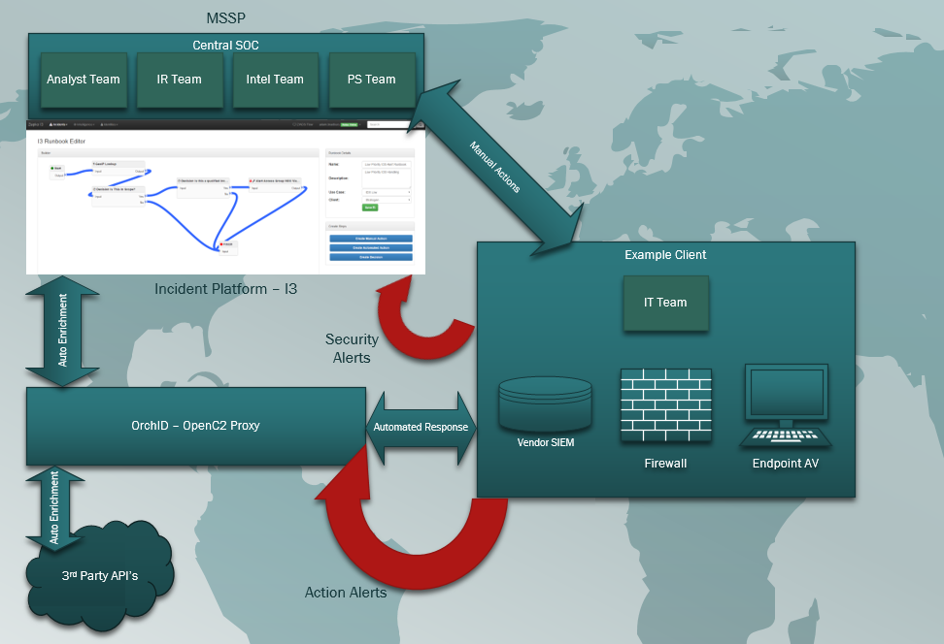
Our current architecture – 80% of our client base
The Problems:
The translator problem
The remote access problem
The change control problem
The long request problem

Slide 9
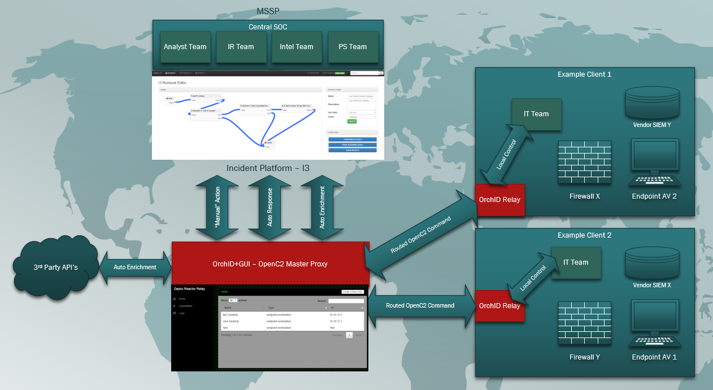
Project: Reactor - Our planned architecture for Autumn 2017

Slide 10
Alerting in OpenC2
Security Incident Alerting:
- Convert to STIX Incidents as soon as possible
- Send to our Incident Management platform via TAXII
- Not a case for OpenC2 (in our deployment)
OpenC2 Alerting:
- Unsolicited messages, i.e. Not in response to an OpenC2 Command
- Solid Examples:
- Orchestrator losing connectivity to a firewall “I no longer can perform action X on actuator Y”
- Changes in downstream capabilities “I can now support DENY on endpoint-laptop actuators”
- Potential Use:
- Long task received (Response: “Ok”) but fails later. Could be resolved by multiple response handling.

Slide 11
Demo

